Slide 1
St. Luke’s Episcopal Church
2025, the year in pictures

Slide 2
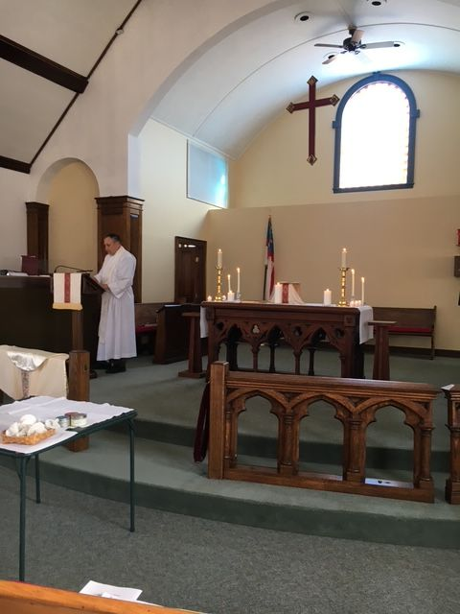
Candlemas Day, Feb. 2

Slide 3
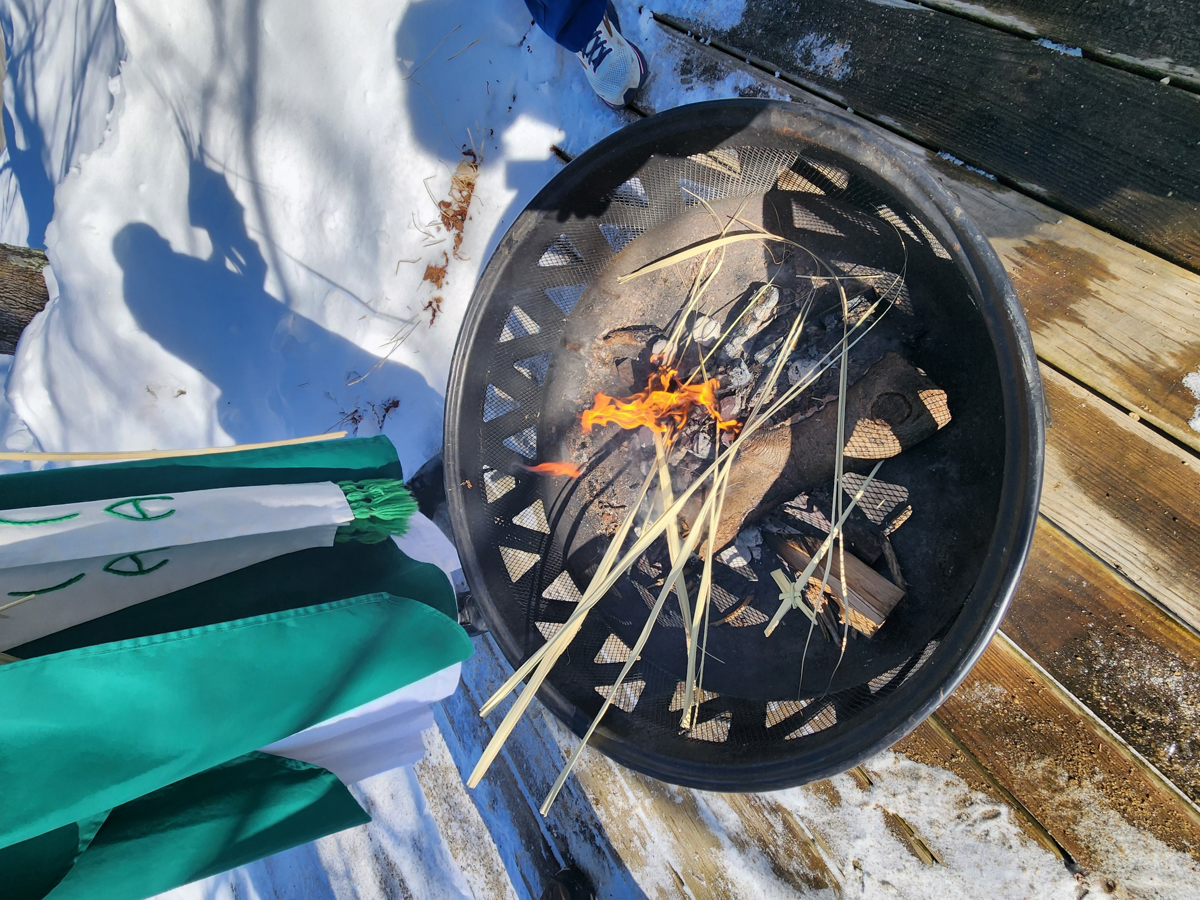
Alleluia Sunday, burning the palms

Slide 4
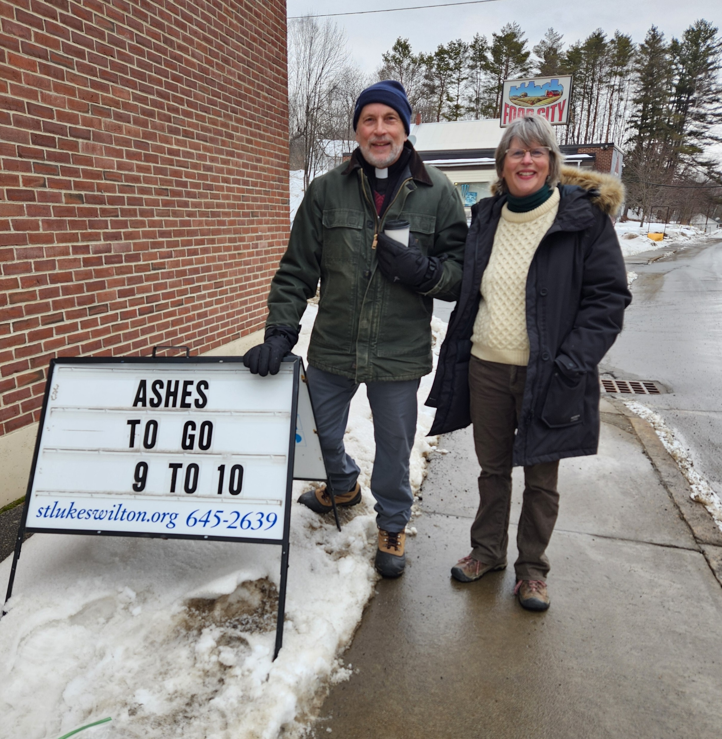
Ash Wednesday, Ashes to Go

Slide 5
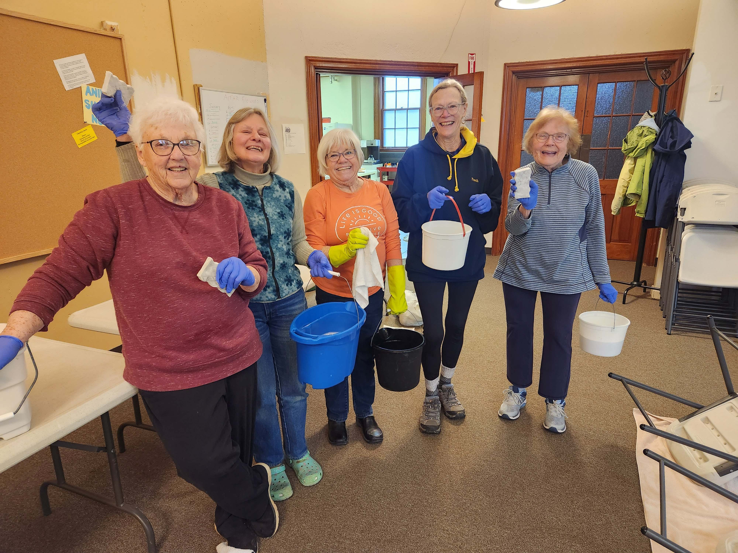
Our kitchen has never been cleaner or more organized!

Slide 6
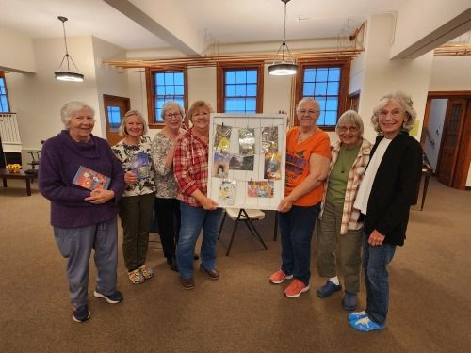
The Soul Collage Group started in March

Slide 7
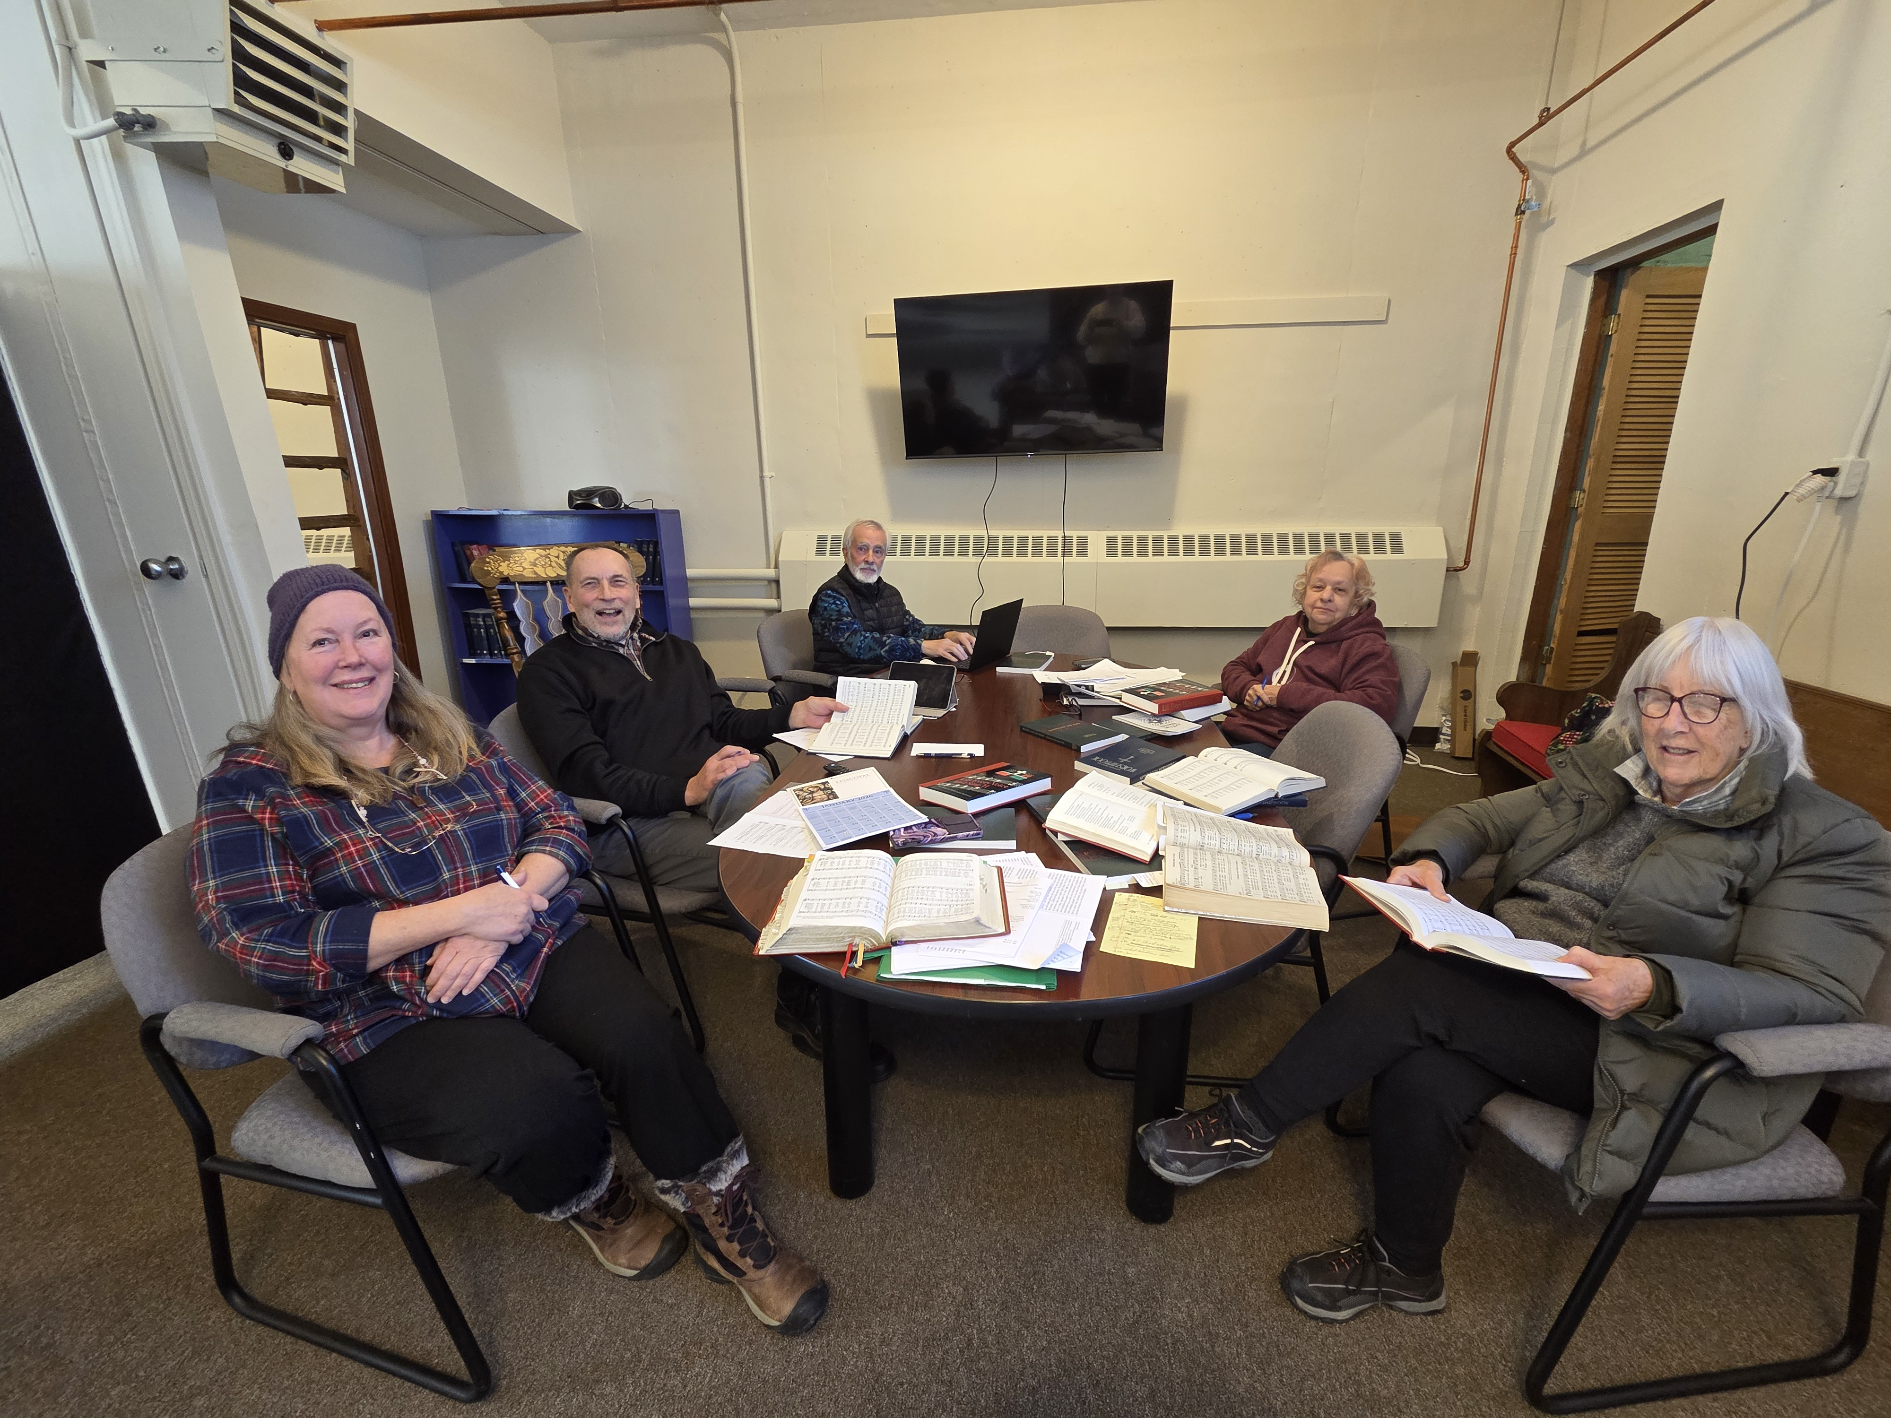
We formed a Worship Committee to plan our liturgies

Slide 8
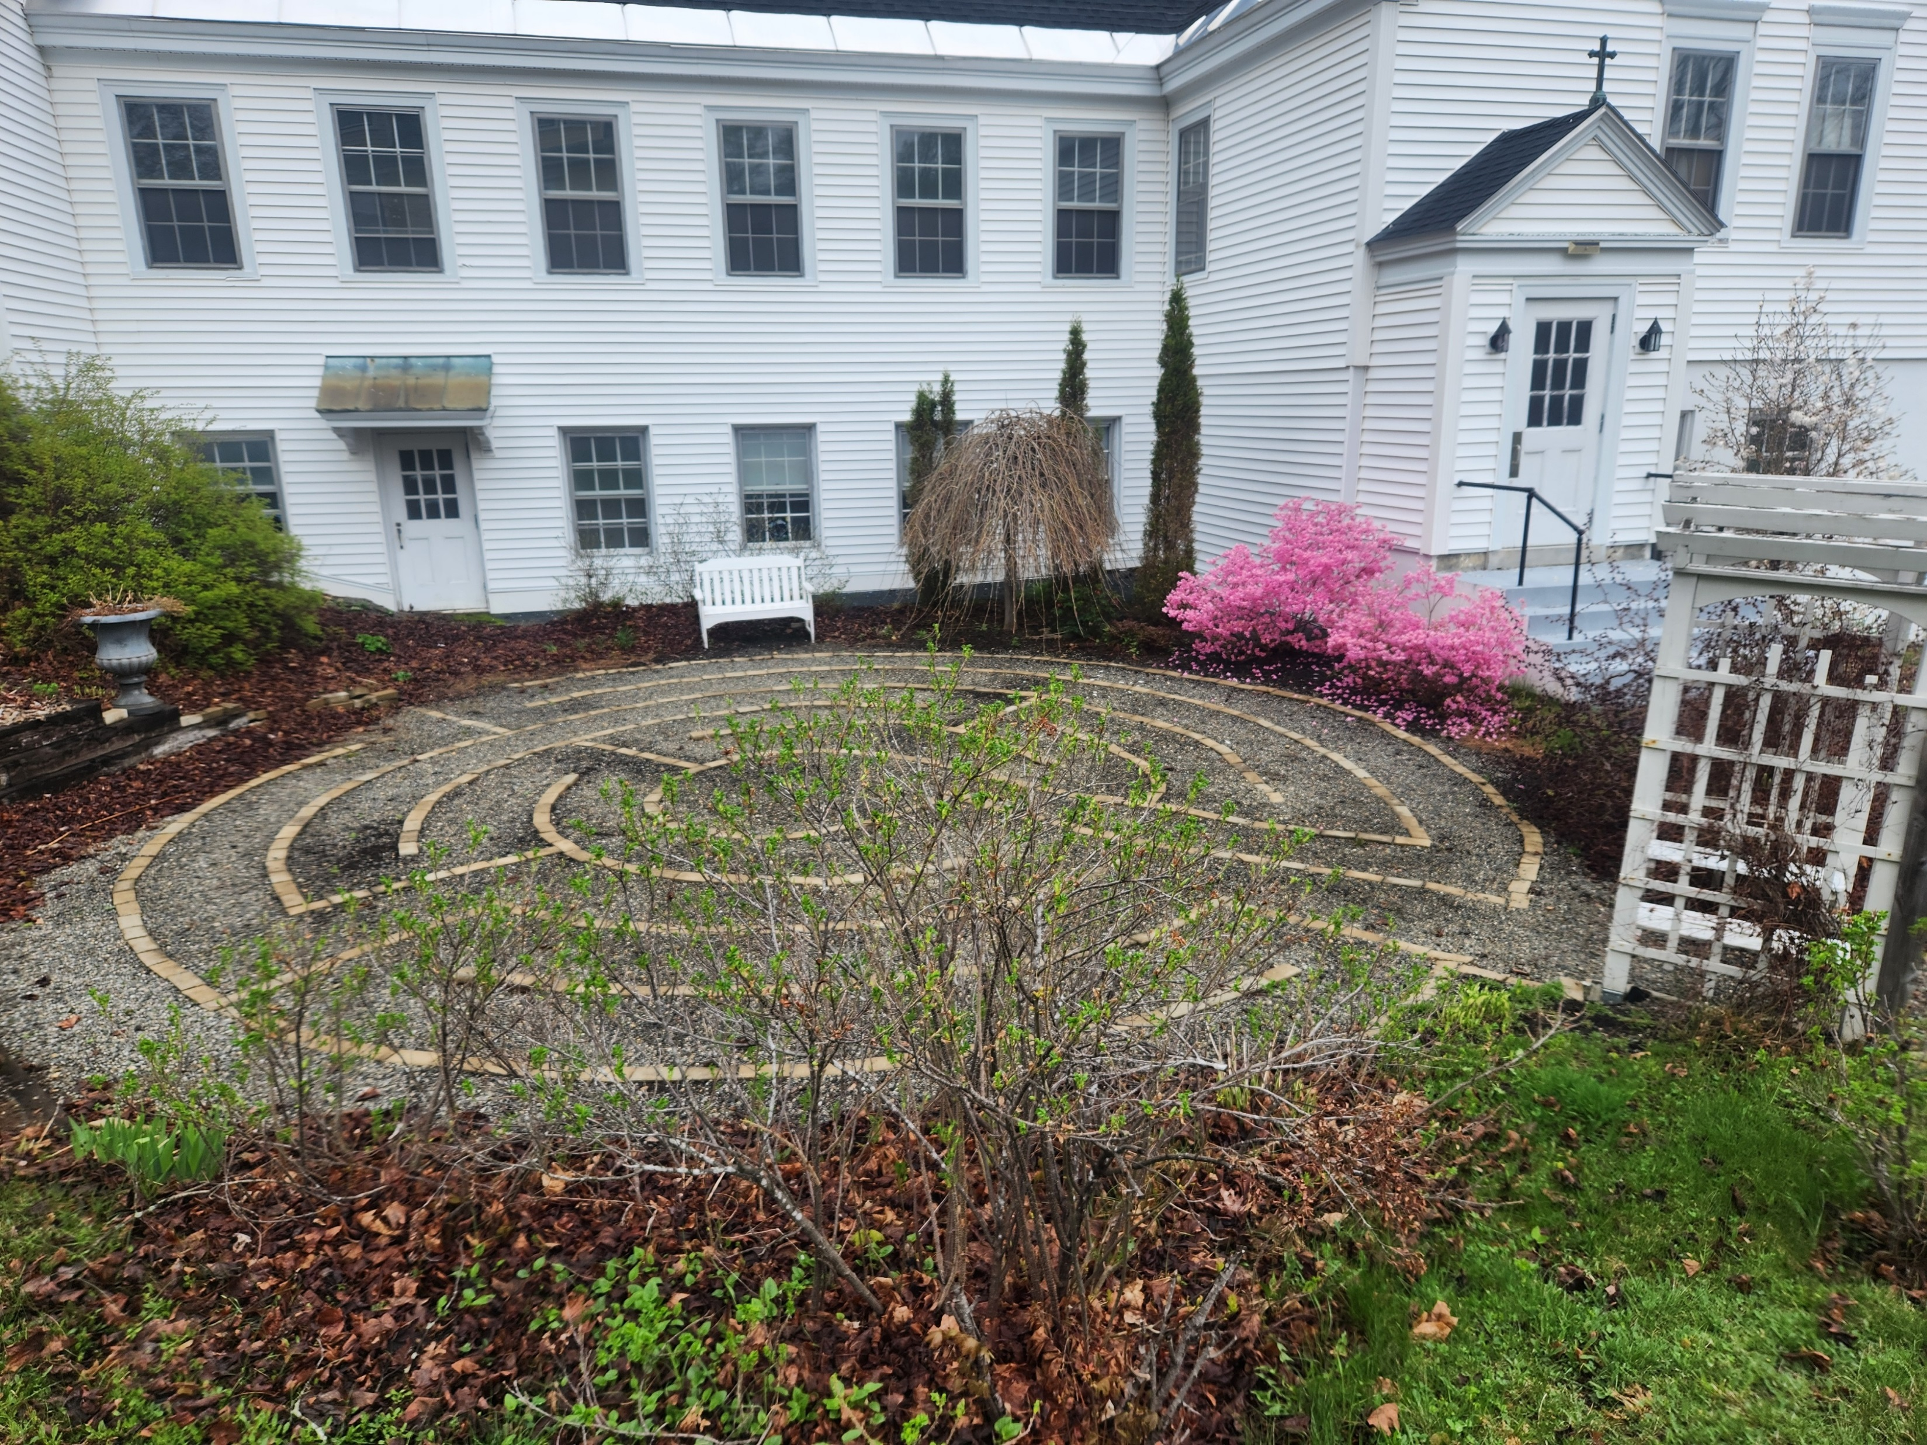
Spring Arrives! (finally)

Slide 9
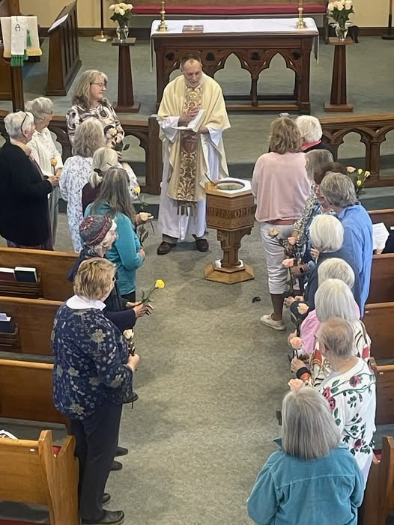
Annual Mother’s Day Blessing

Slide 10
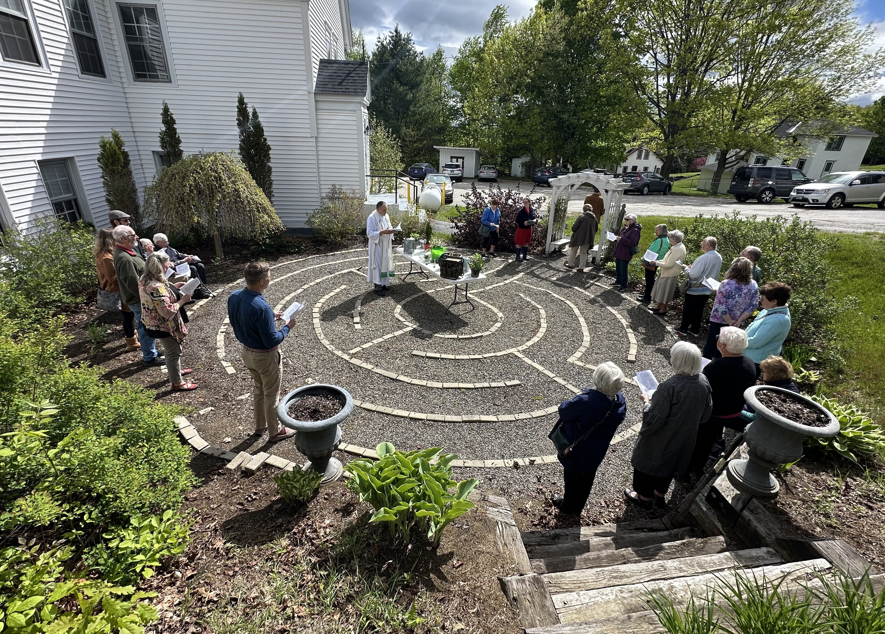
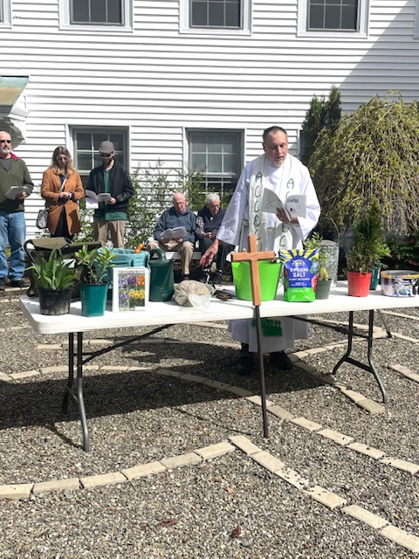
Rogation Sunday, May 25

Slide 11
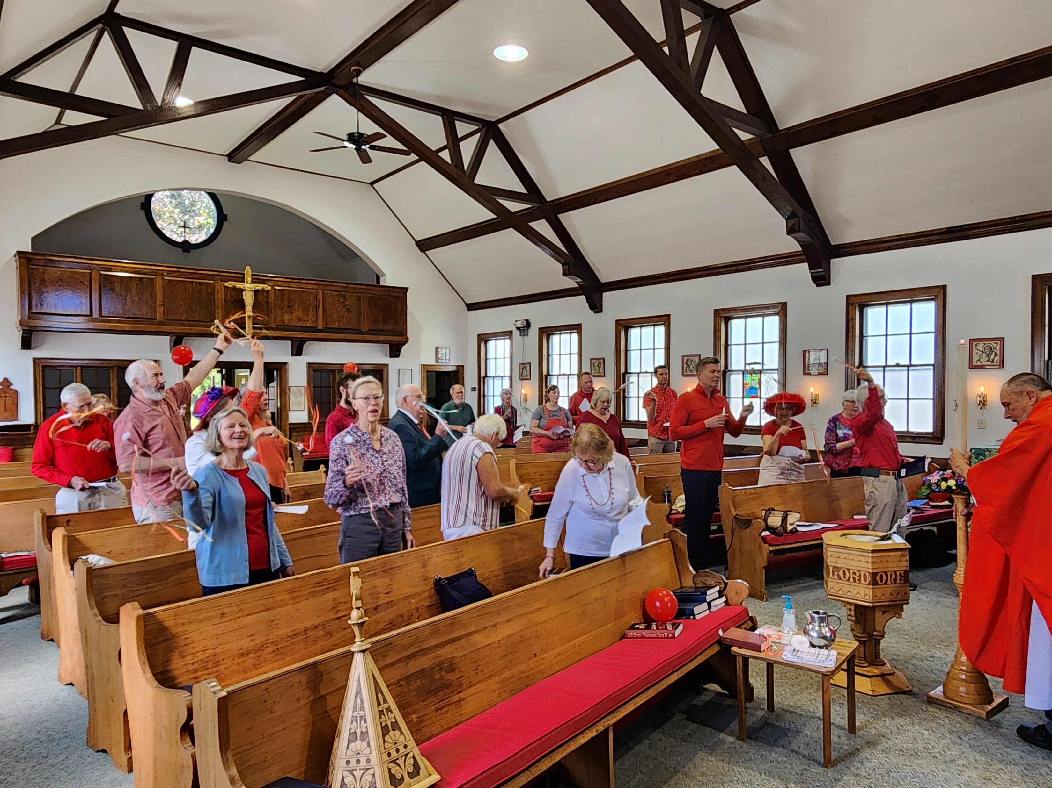
Pentecost Sunday, June 8

Slide 12
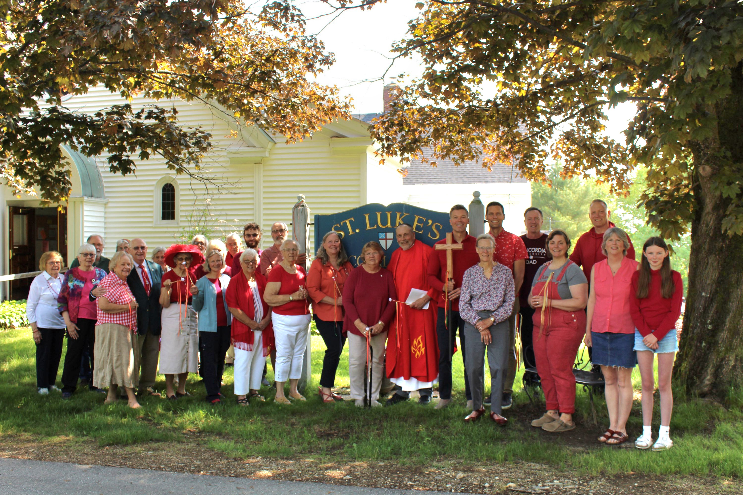
Congregational
Photo
Pentecost 2025

Slide 13
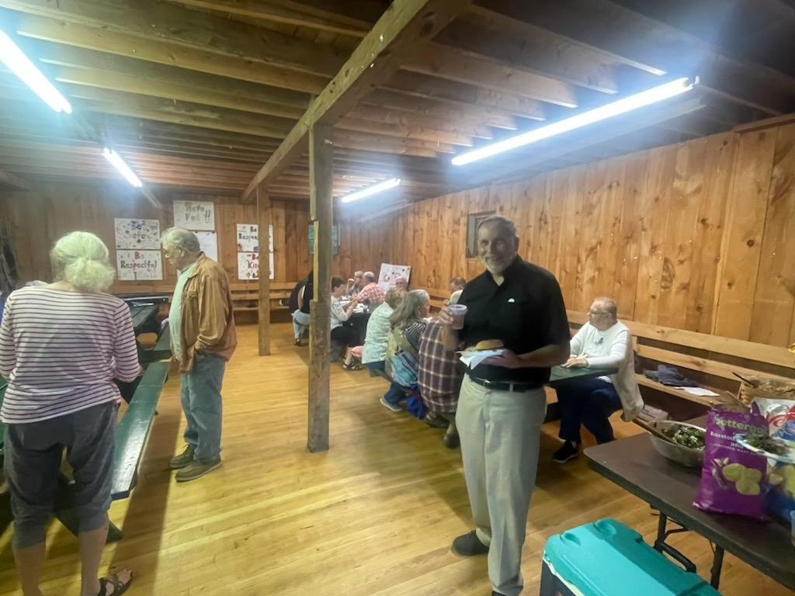
An indoor church picnic in July. So what if it rained!

Slide 14
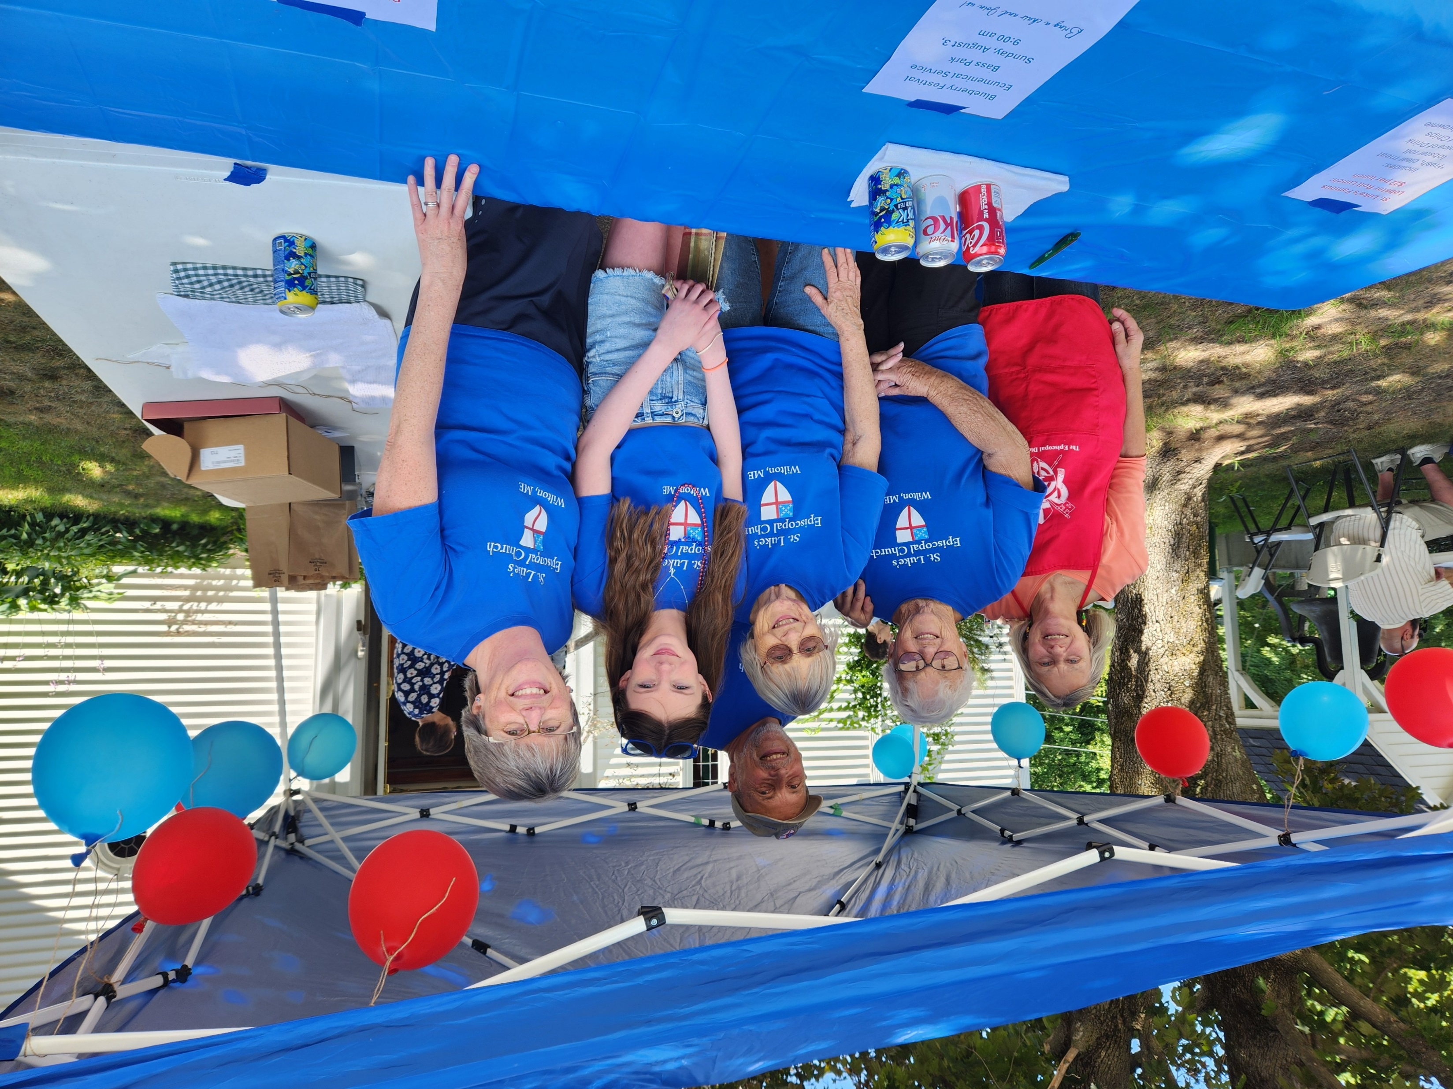
With thanks to our sales crew but to so many others who worked on lunch bags, mixing the lobster, stuffing rolls, icing drinks, donating brownies and drinks, setting up, and breaking down. It takes a lot of effort and you are appreciated. There were many satisfied customers who stayed to dine under the shade trees. It was a great opportunity to work as a team and to greet community friends and meet new people.

Slide 15
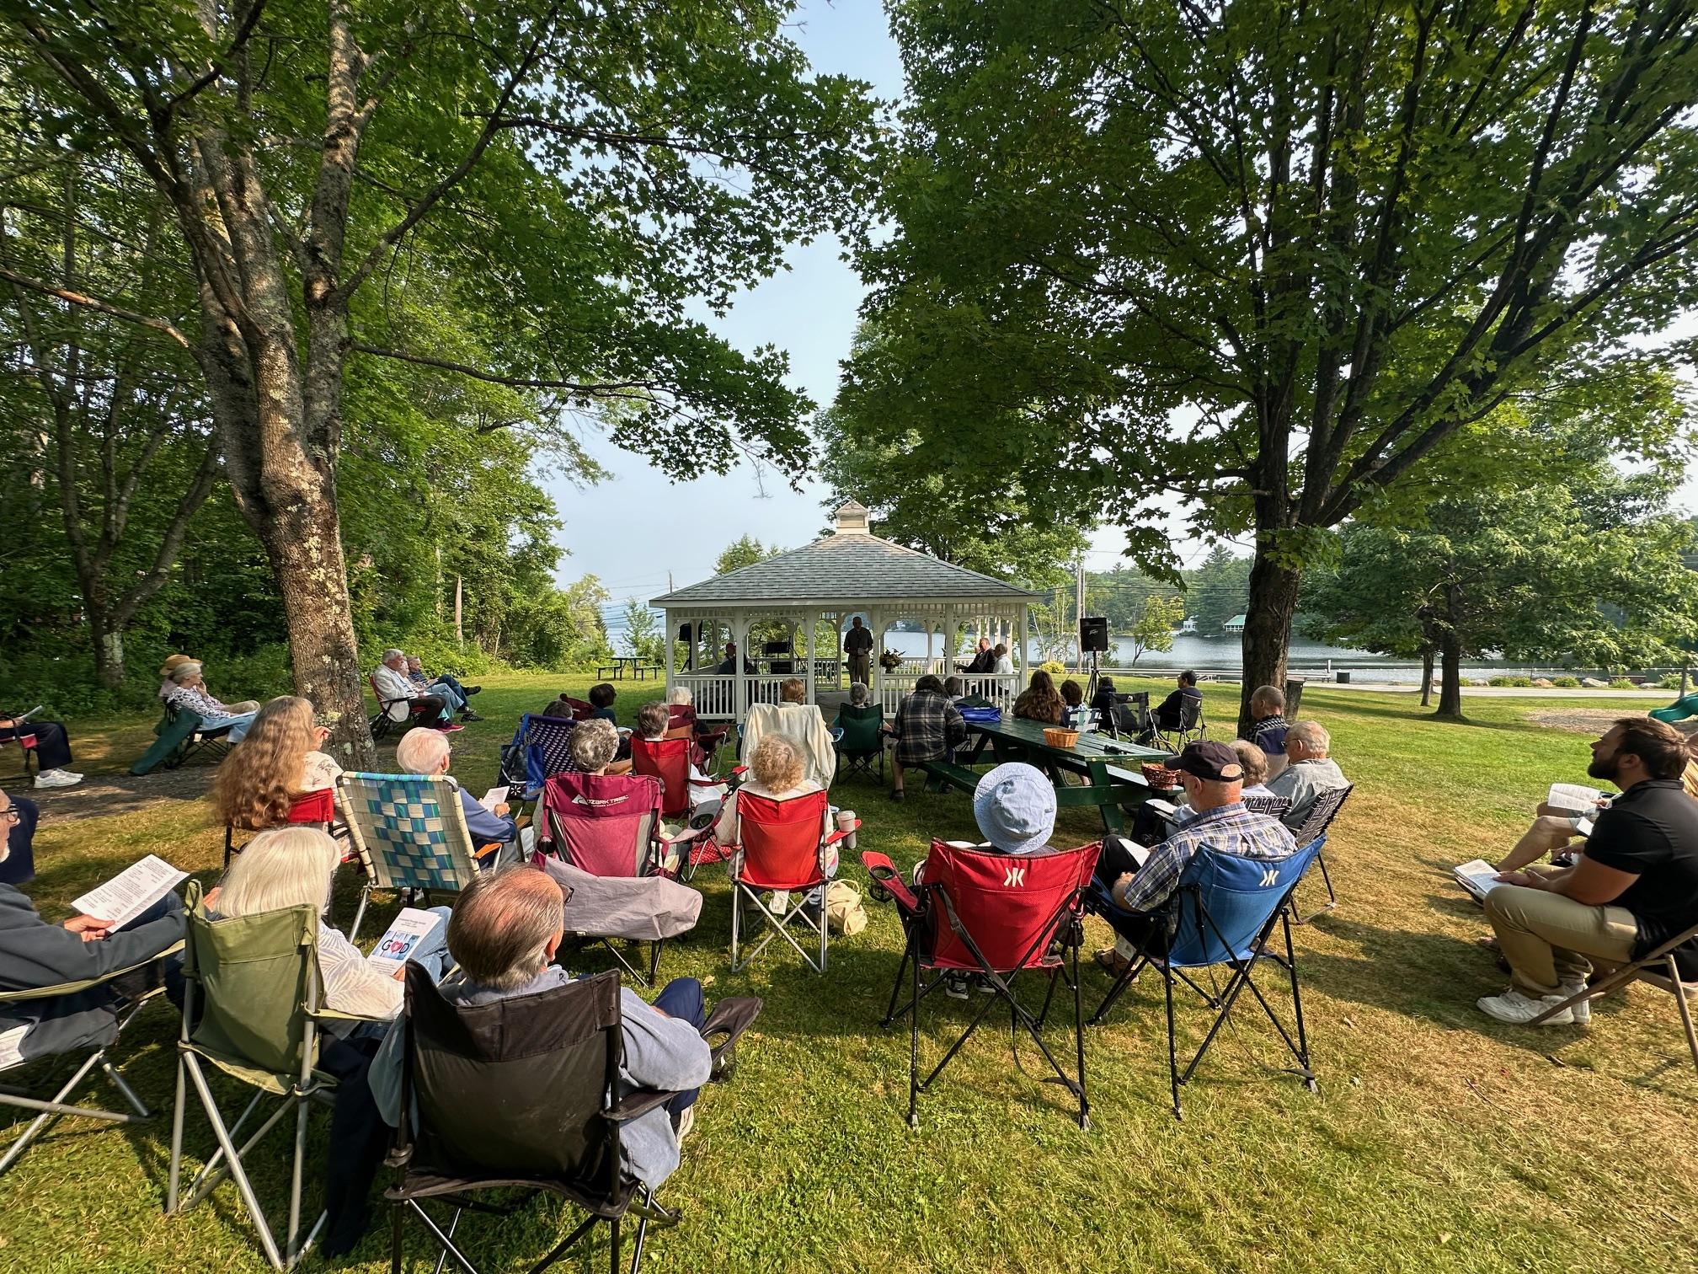
Ecumenical Service, Bass Park, August 3

Slide 16
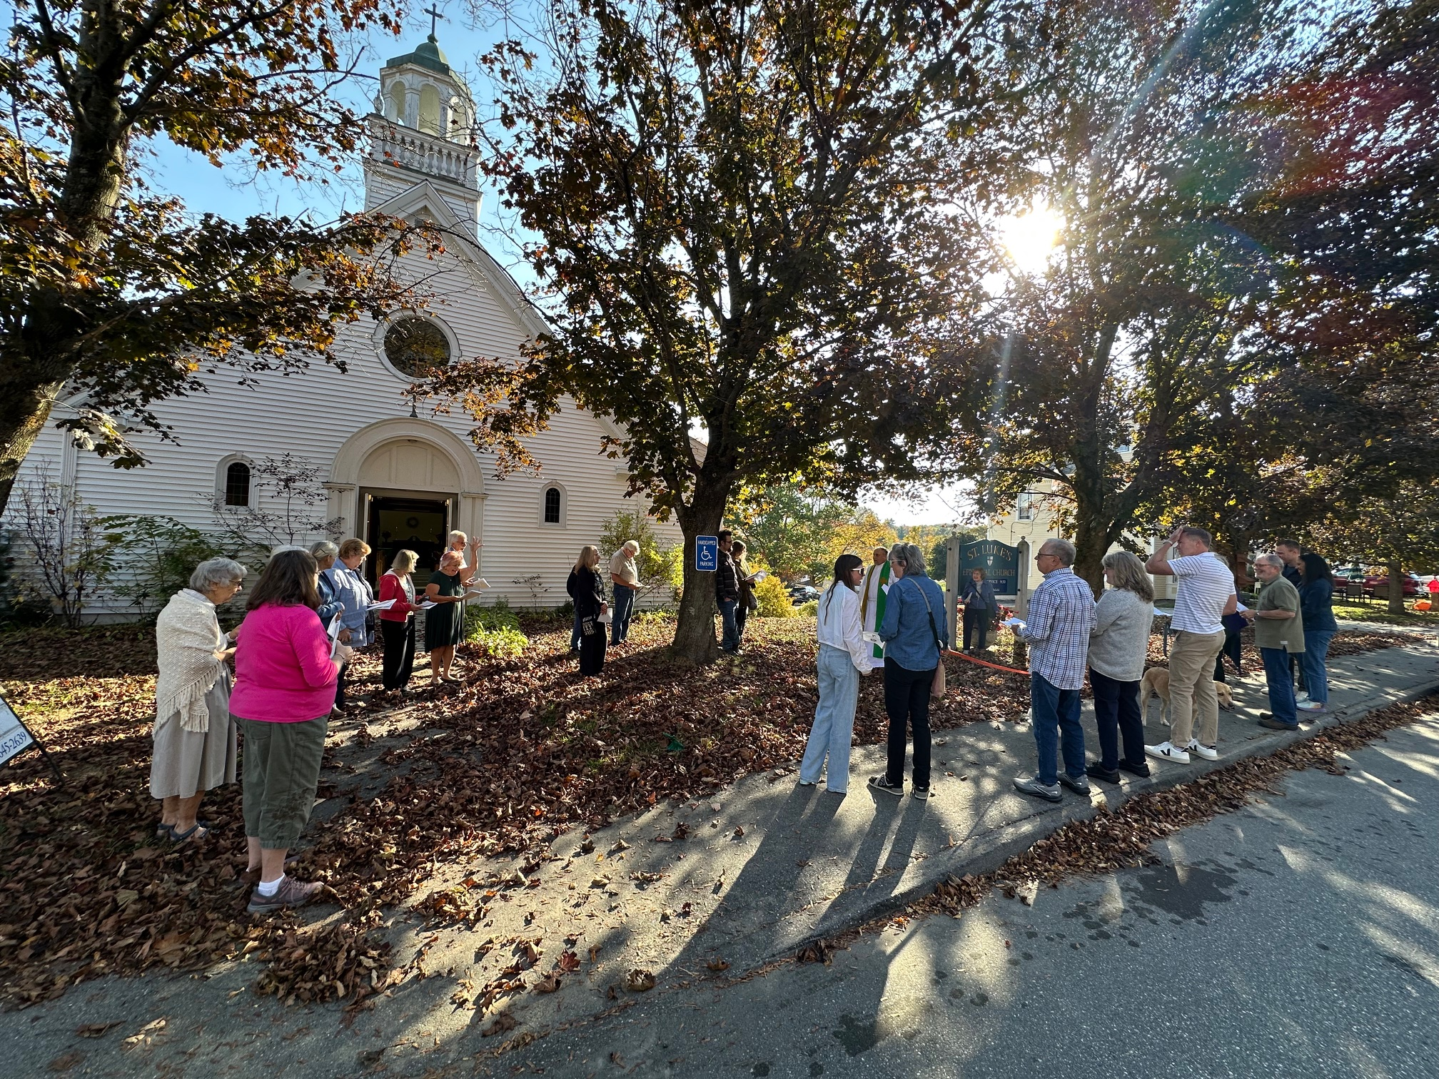
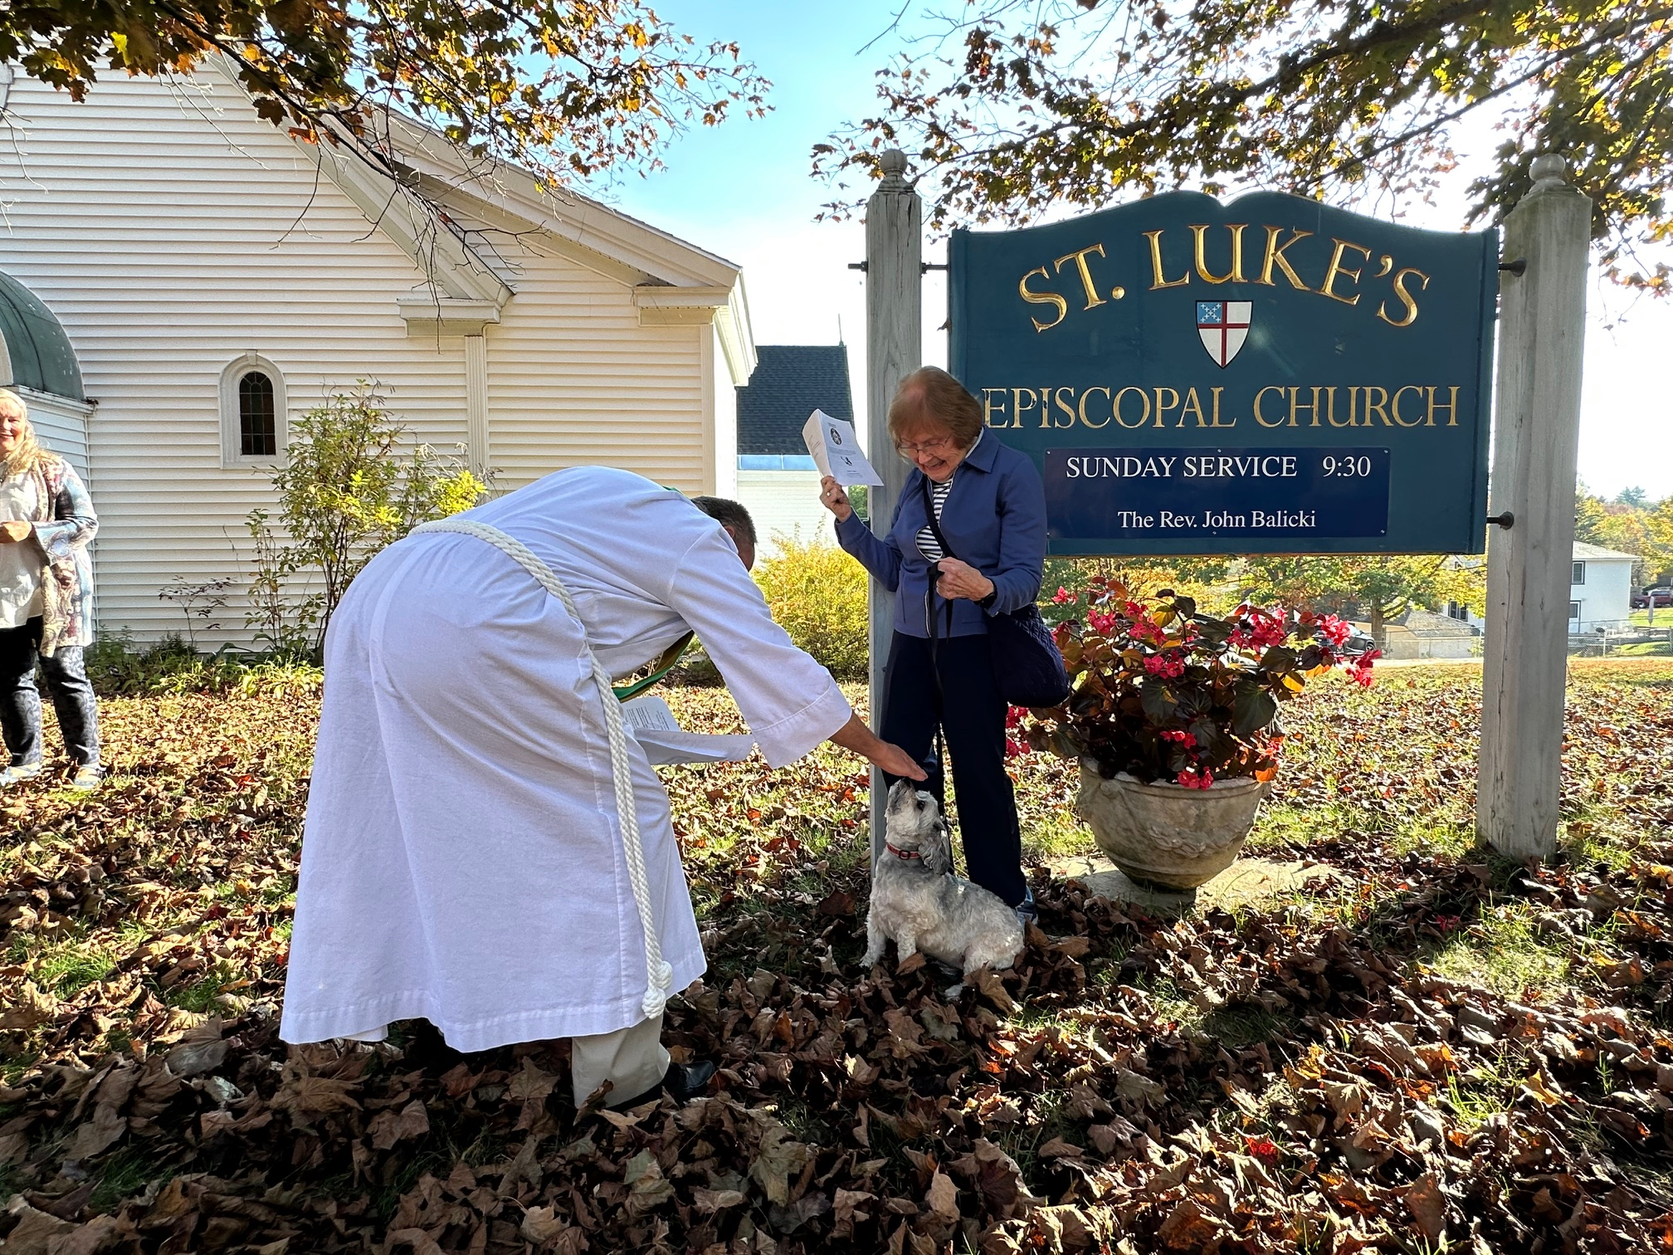
St. Francis Sunday, October 5

Slide 17
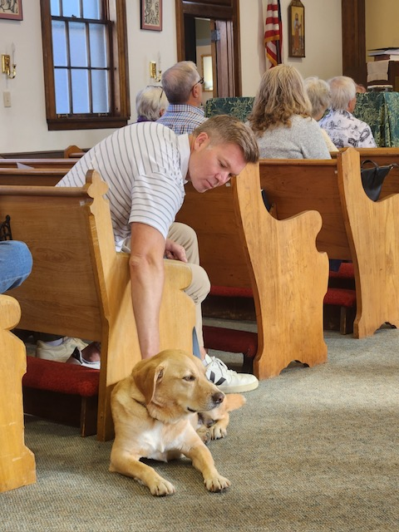
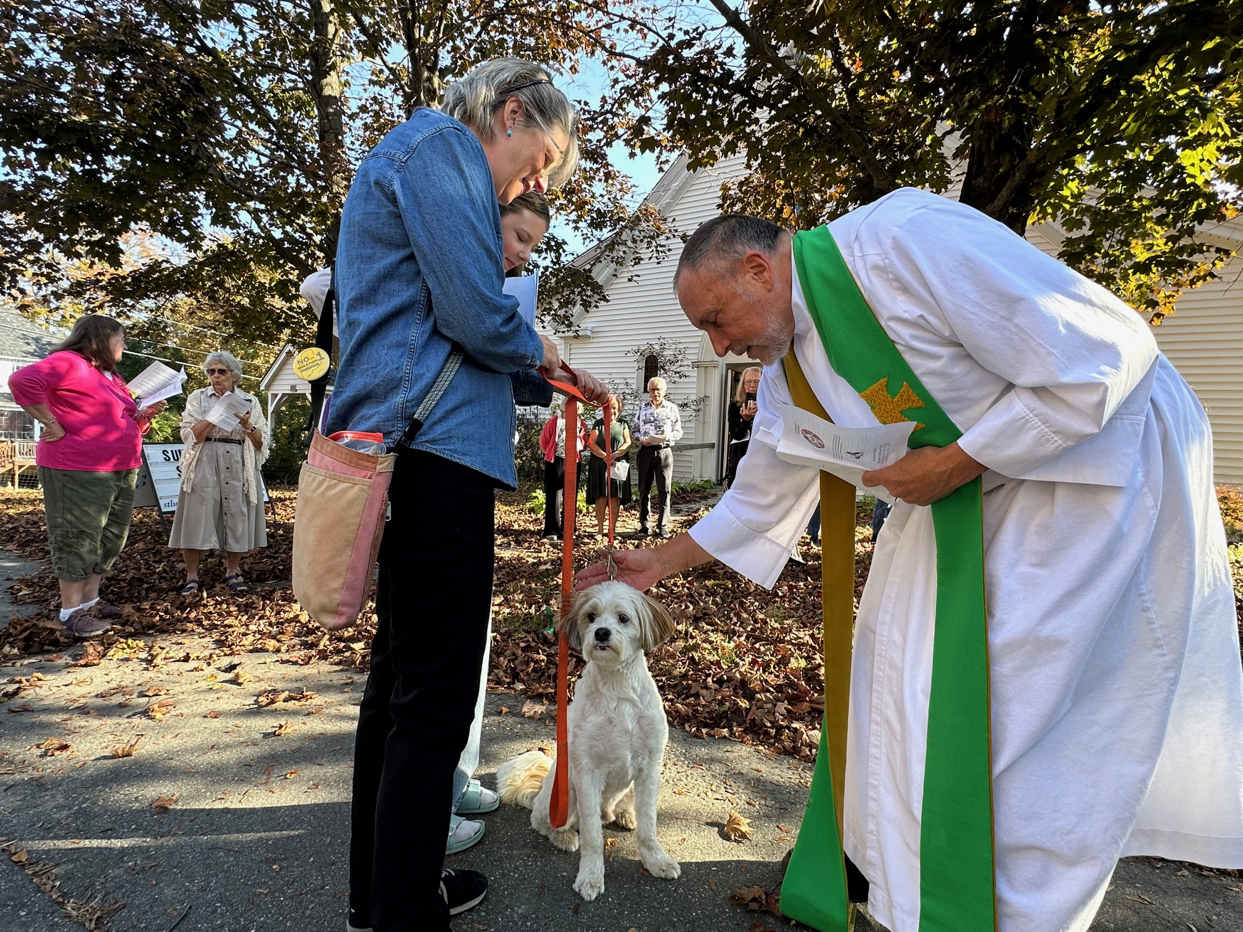
Blessing of the Animals

Slide 18
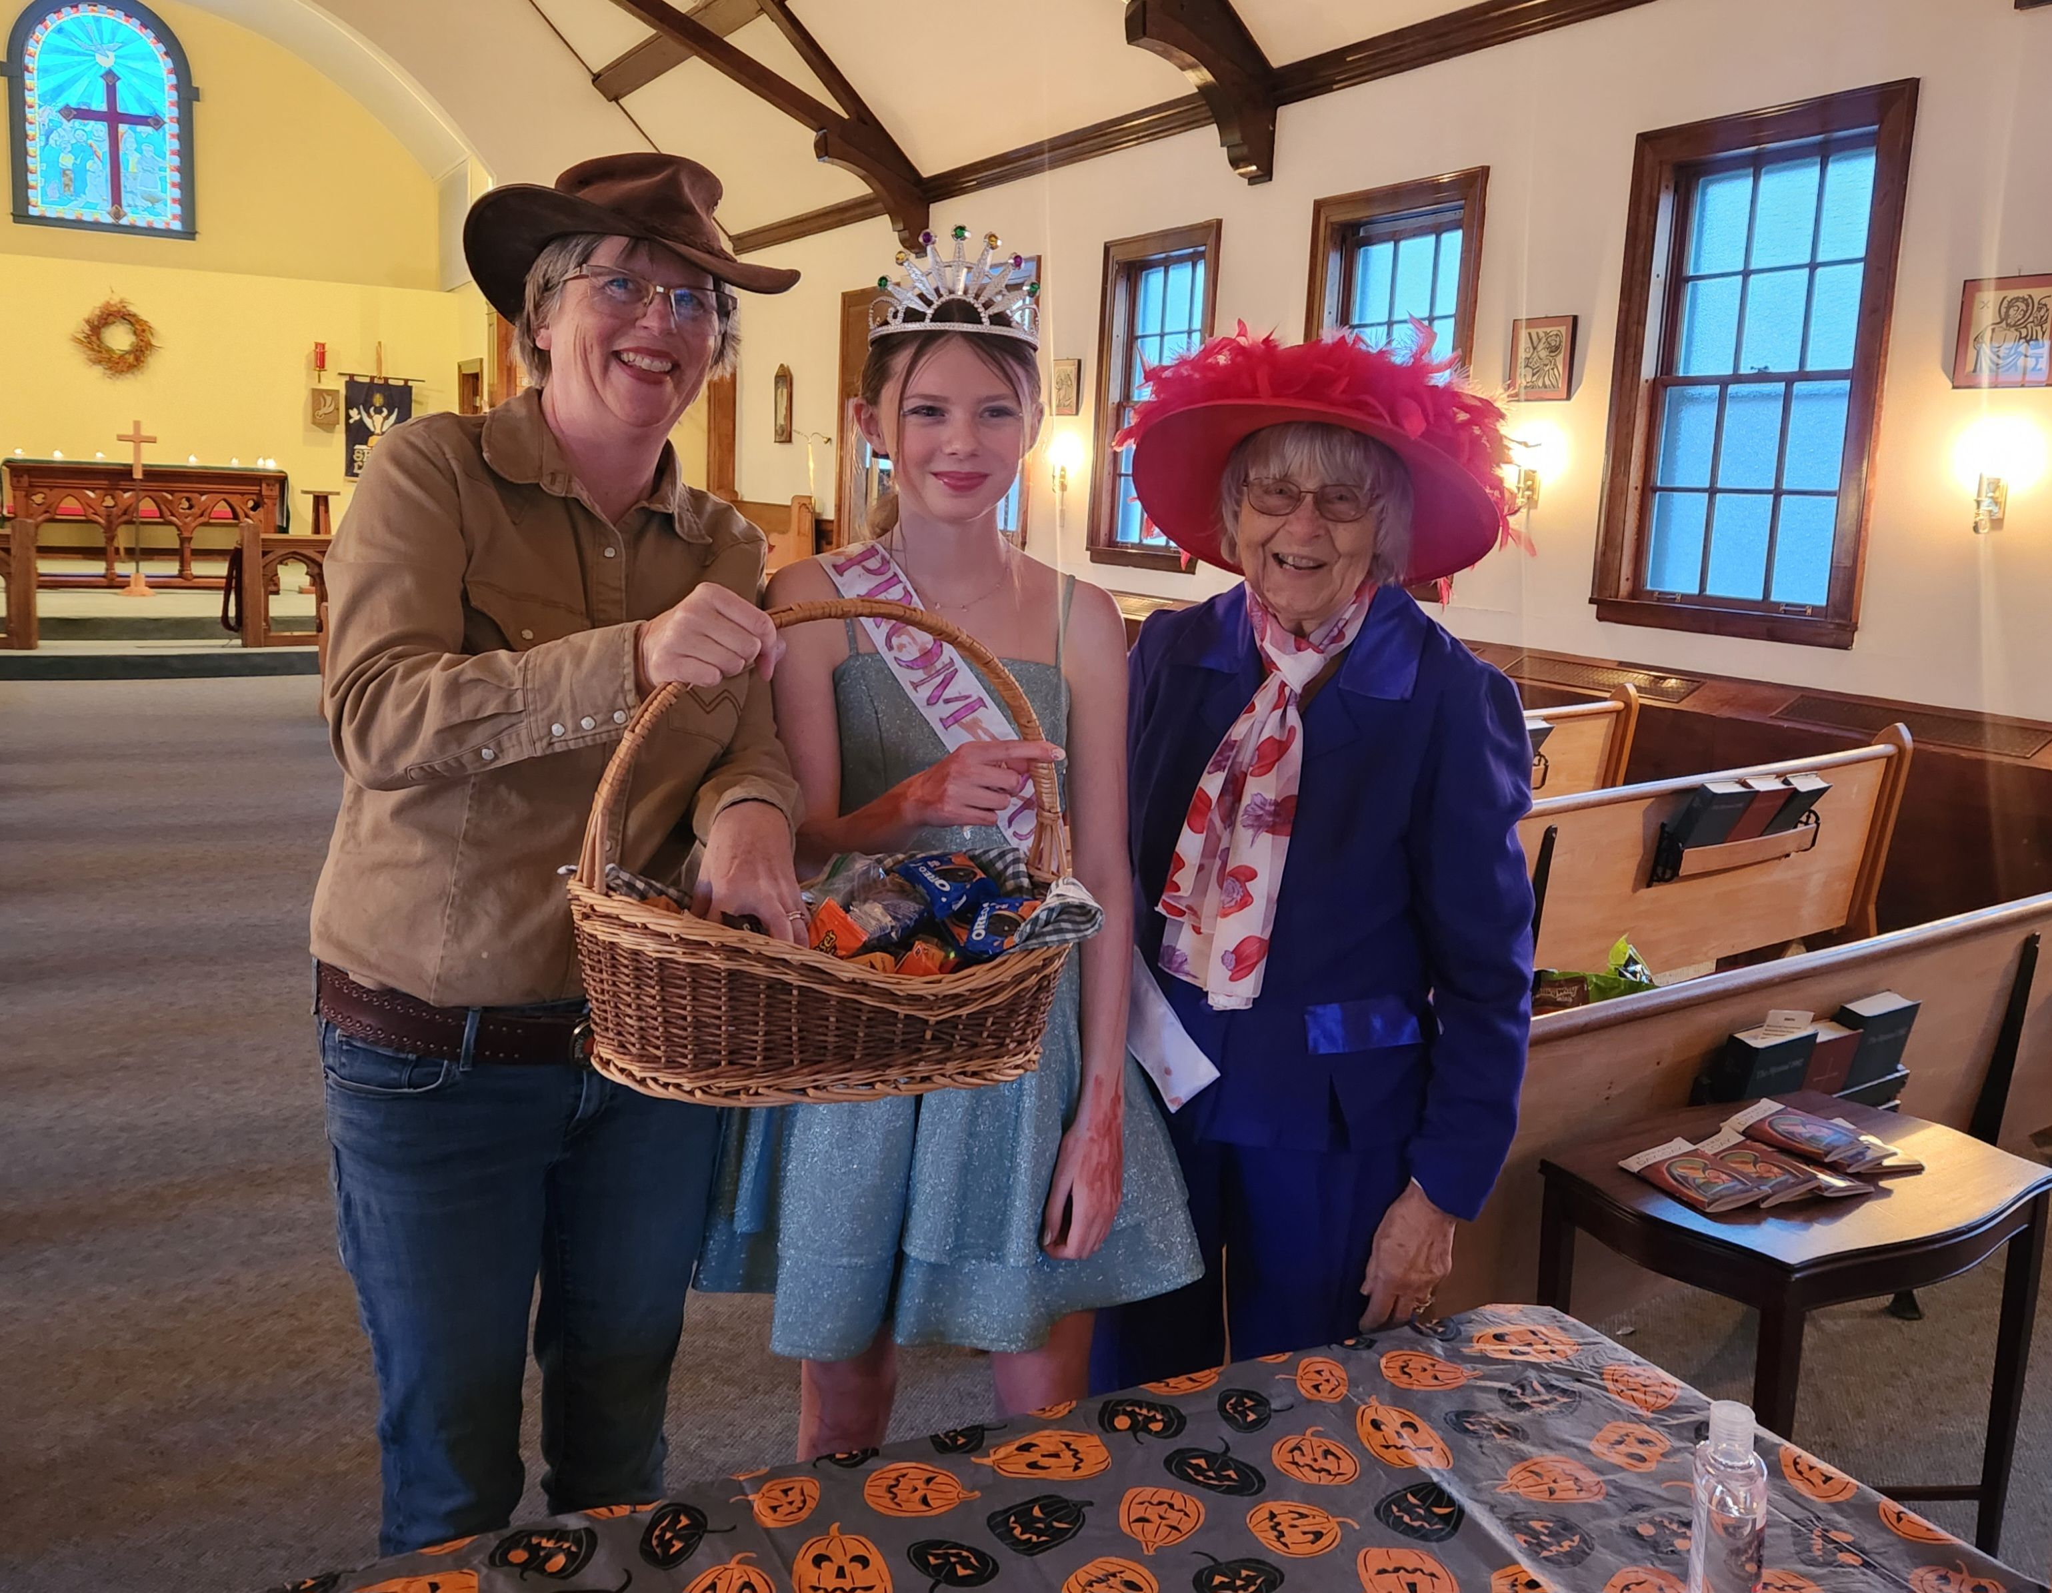
Halloween

Slide 19
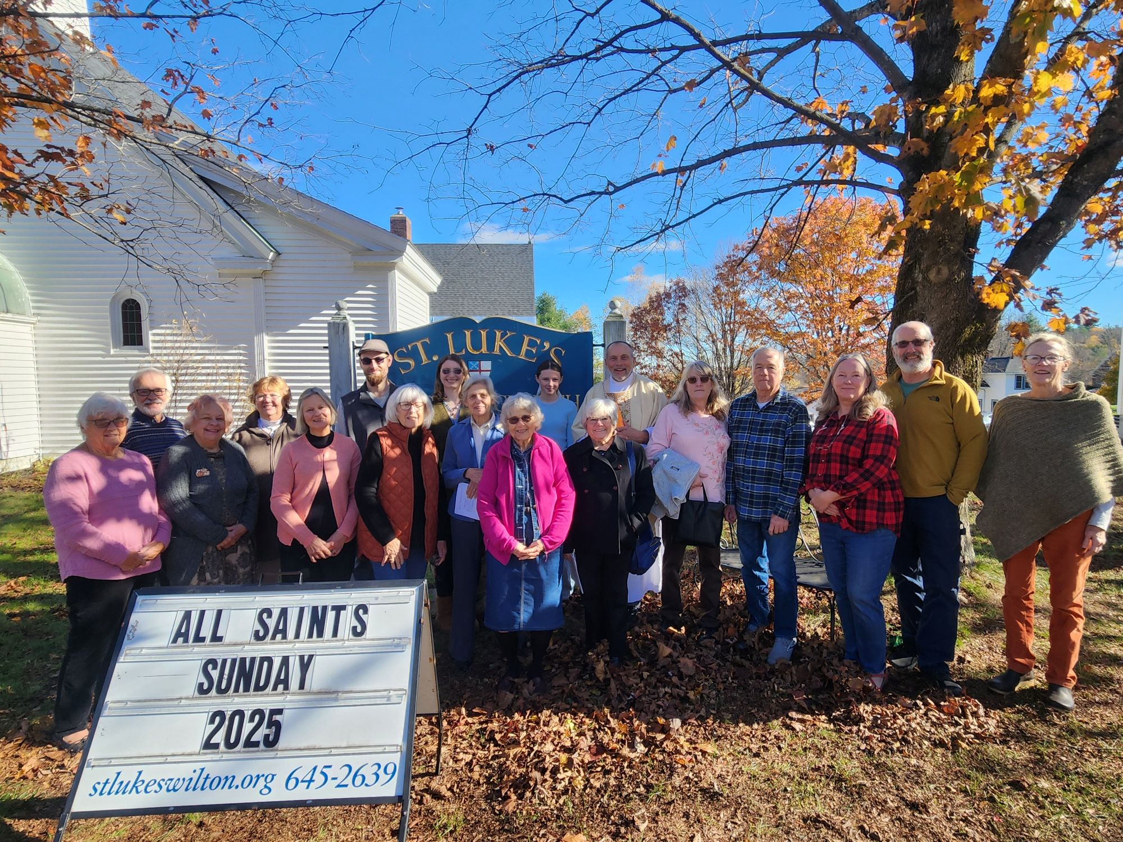
All Saints Sunday, November 2

Slide 20
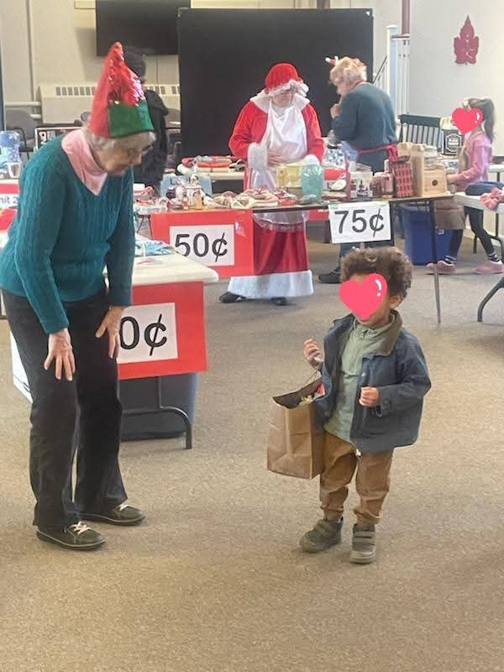
Santa’s Workshop, Dec. 13

Slide 21
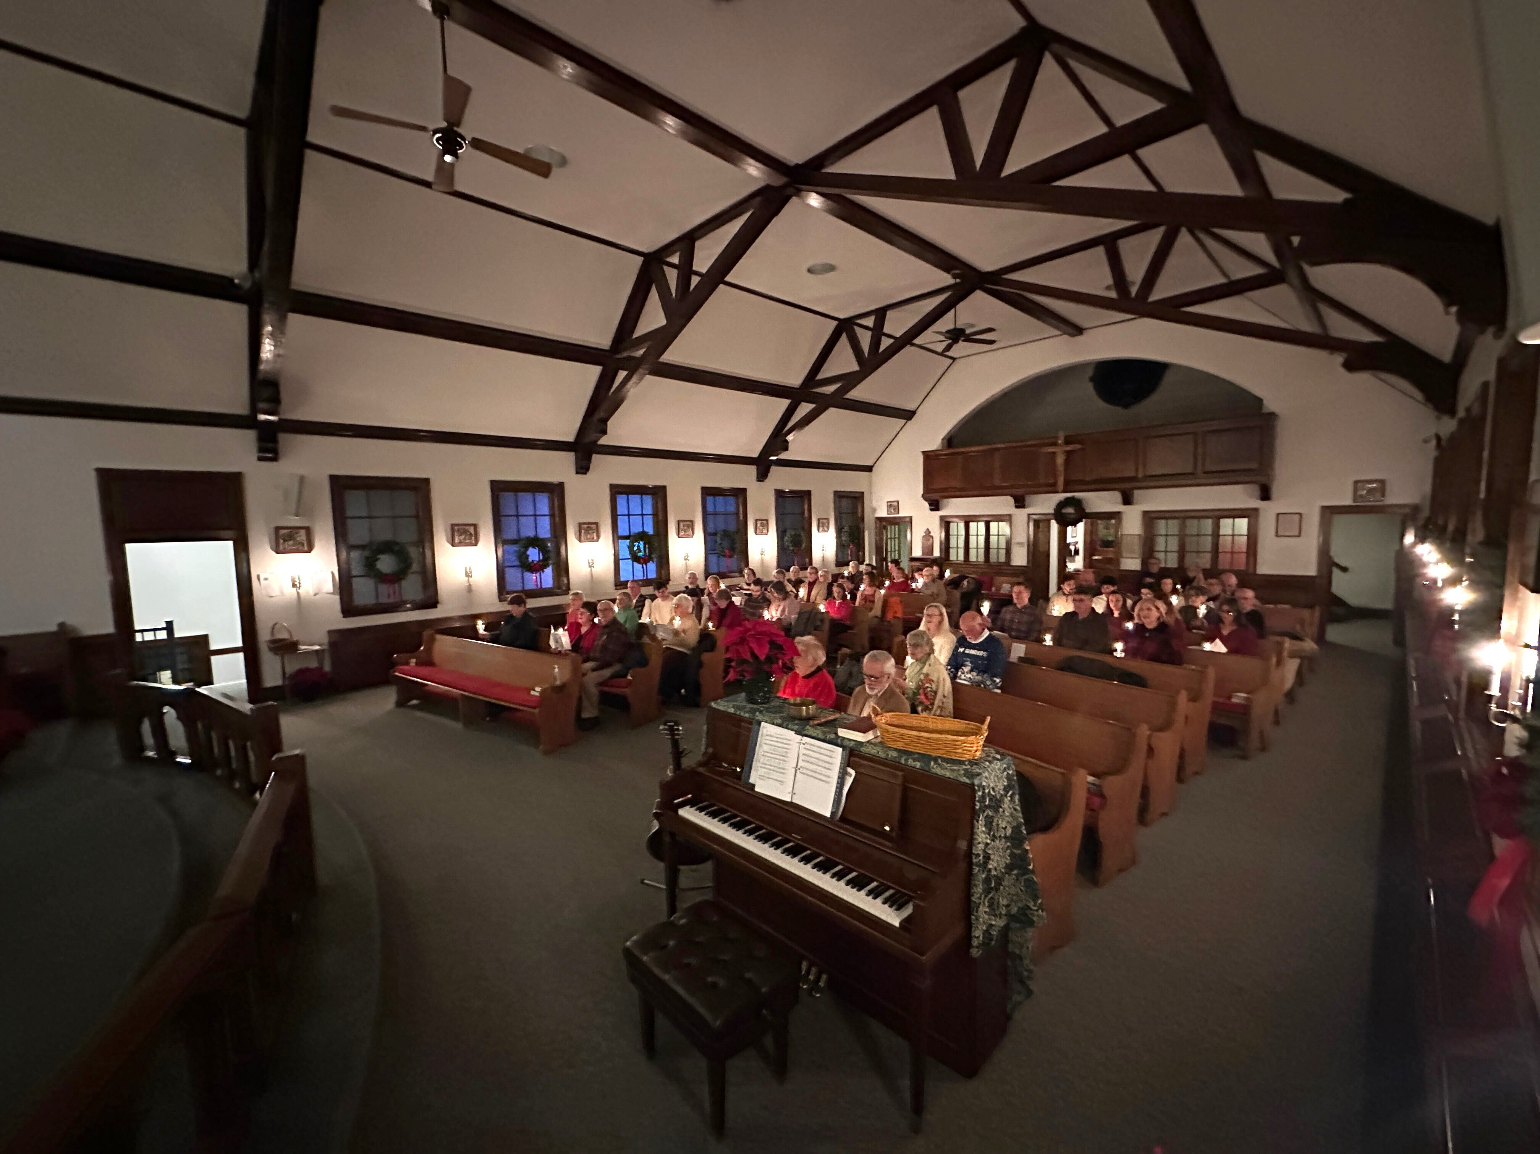
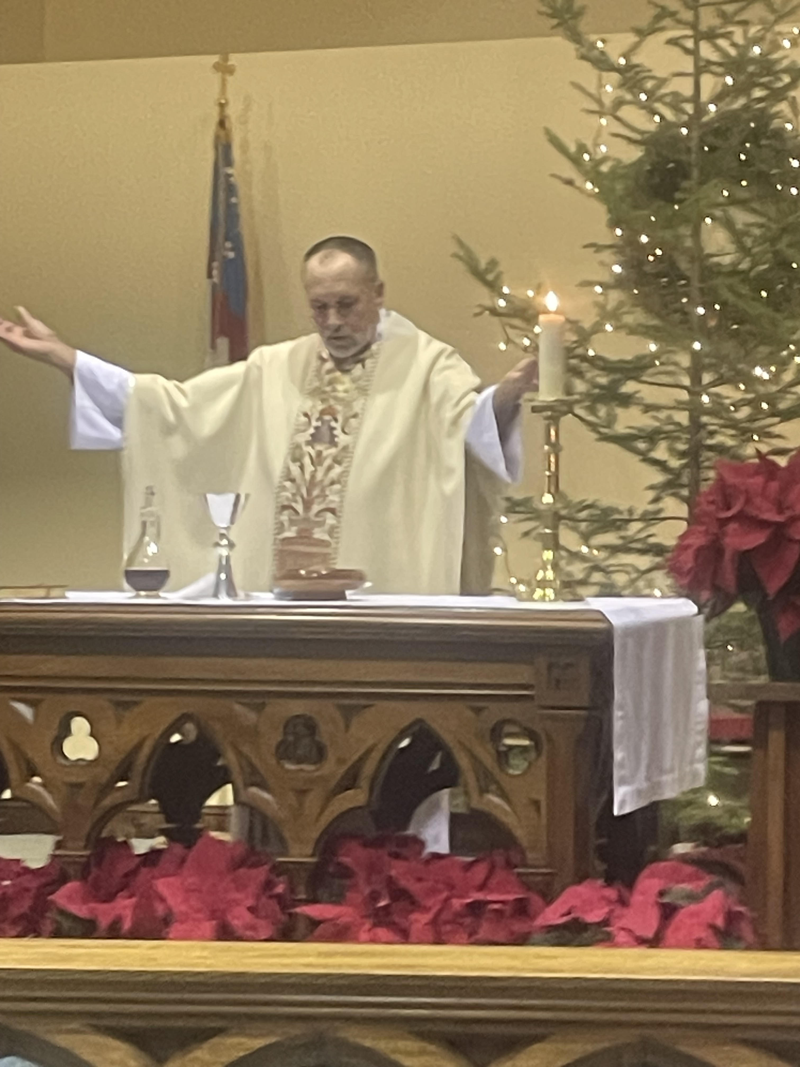
Christmas Eve 2025

Slide 22
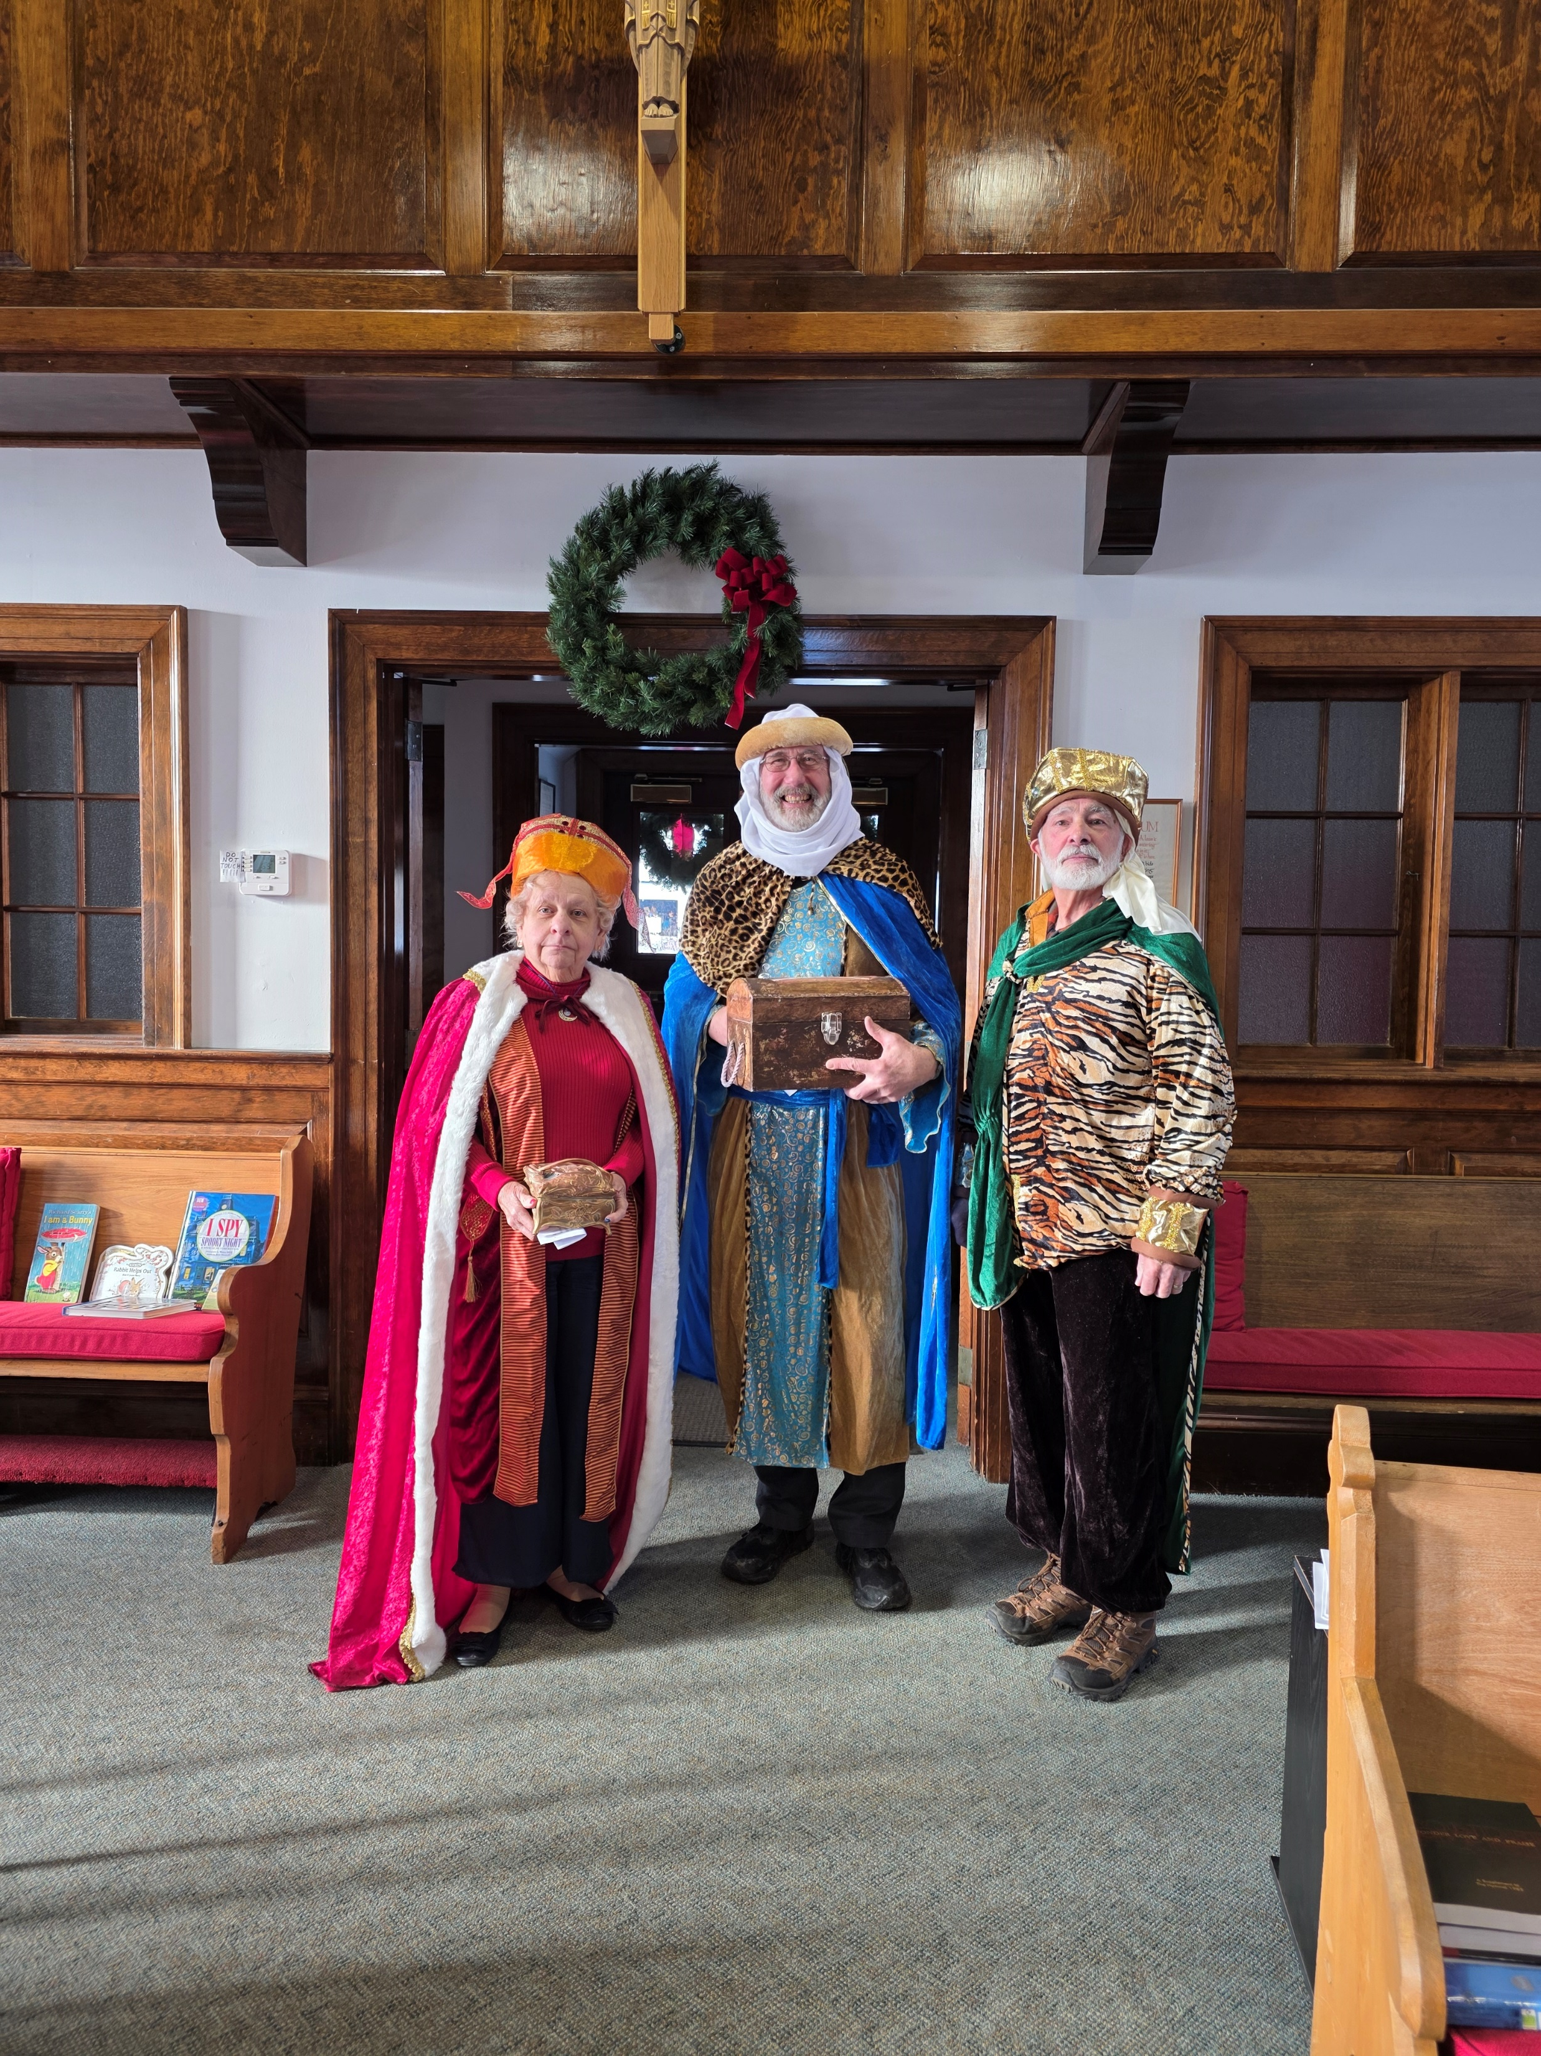
Epiphany 2026 an appearance by royalty!

Slide 23
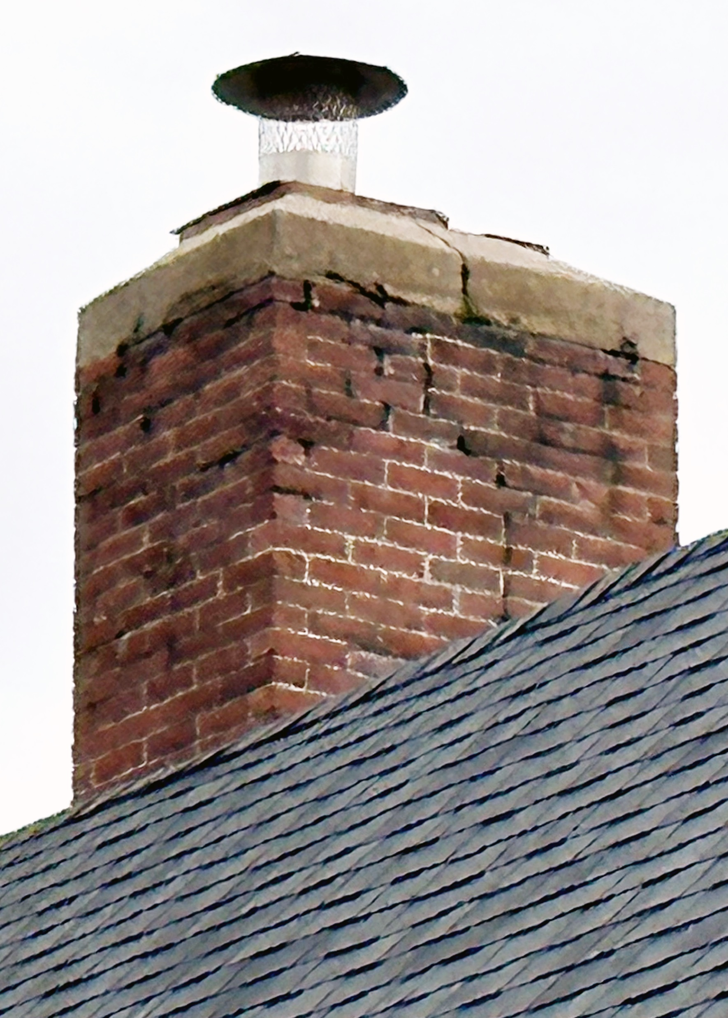
Our poor chimney

Slide 24
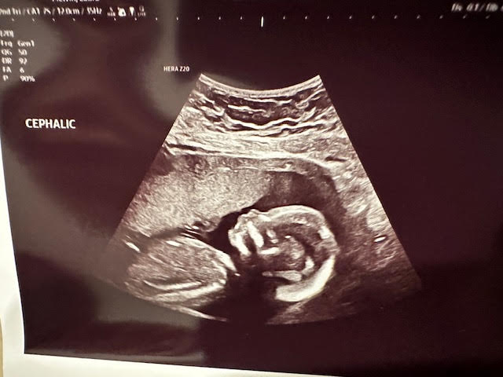
Coming Soon in 2026: August Emmanuel

